Slide 1
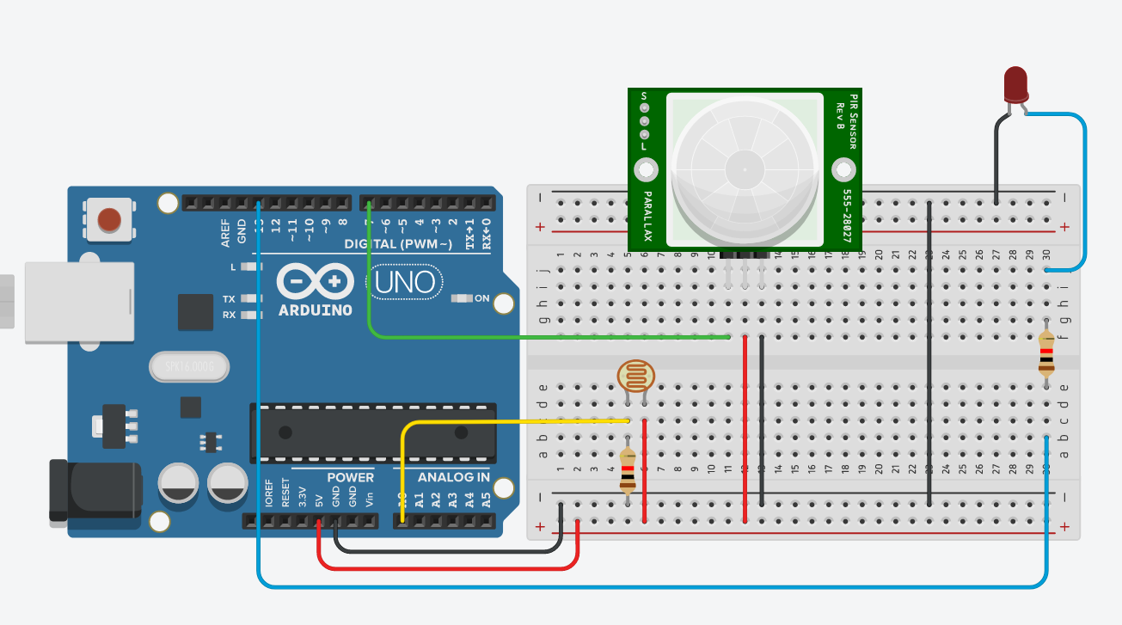
CS341 Lab 6:
Driveway light
https://github.com/whittyh/CS341

Slide 2
Lab 6 Objectives:
Create a driveway light that turns on with motion at night
Interface with a Motion Sensor to detect motion
Interface with a PIR to detect light

Slide 3
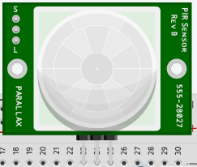
Infrared Motion Sensor:
Detects motion by measuring changes in heat
Digital sensor, returns a 1 or 0 depending on motion:
1 = motion
0 = no motion

Slide 4

Photoresistor:
A form of variable resistor that changes resistance based on the light that hits the sensor
Analog sensor, requires analog input and returns a value based on the amount of light detected.
Rather than a 1 or 0 (digital sensors) we get a value of range 0-1023 that represents the light sensed.

Slide 5
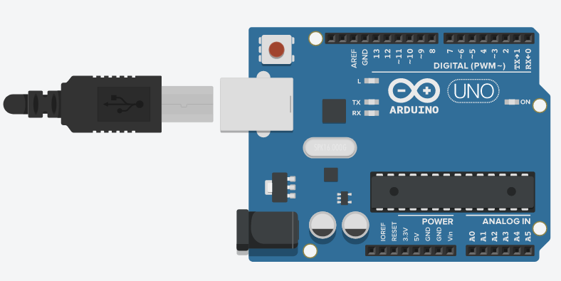
Analog (and Digital) Pins:
Digital Pins
Analog Pins:
Read voltage between 0-5v
Interprets voltage as value between 0 – 1023
Analog pins can be used for digital sensors but not vice versa
Analog Pins
Example of reading from an analog pin:
analogRead(A0);

Slide 6
Approach:
Complete circuit and implement the following logic:
Loop() {
if (motion) {
if (light < 250) {
// light bulb on
delay (waitTime);
}
} else {
//turn the light off if there's no motion
}
delay(250);
}

Slide 7
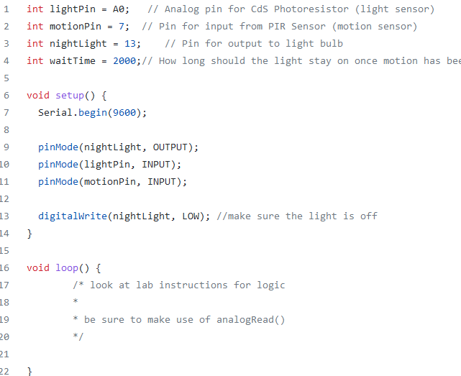

Slide 8
Useful Functions:
// is there any motion?
digitalRead(motionPin) // will return HIGH or LOW
digitalWrite(nightLight, HIGH) // turn on the light
// reads the light value (returns 0-1023)
analogRead(lightPin)

